Slide 1
Getting ready to start training
Module one: Context of Foster care

Slide 2
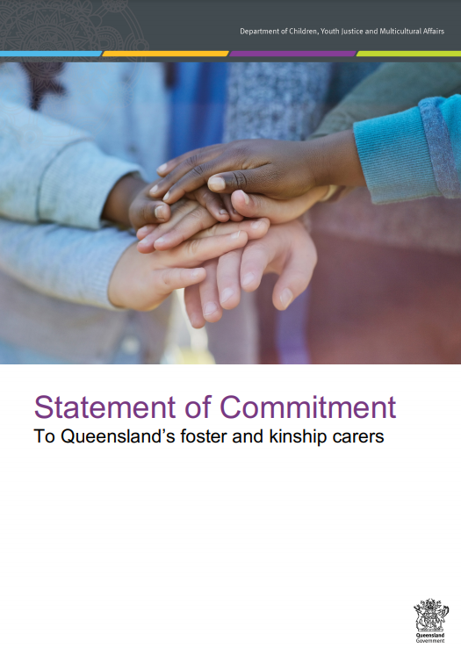
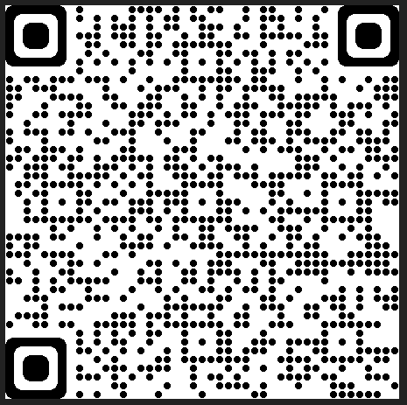
Thank you for taking your first steps to become a Queensland Foster Carer.
Queensland foster carers make an invaluable contribution and commitment to the lives of children and young people in care.
To recognise and support that commitment the Statement of Commitment To Queensland’s foster and kinship carers has been made by the Queensland Government and child protection peak bodies.
This document reflects the shared commitment of our partnership with foster carers, for the benefit of children and young people in care. The statement also acknowledges the unique role cares have as volunteers in this partnership and promotes their critical role as part of a team in opening their homes to care for children and young people.
You can review this commitment in full here (QR-Code):
https://www.qld.gov.au/__data/assets/pdf_file/0014/152321/statement-of-commitment.pdf

Slide 3
Getting ready to start - Training Modules
Each participant will be assessed throughout the four modules on the following learning objectives:
Module one – context of foster care
An understanding of the process of how children and young people come into care and the impact of this process, and why children and young people require a care arrangement.
Module two – understanding the past for a child or young person
An understanding of trauma and related behaviours for a child or young person who is in care arrangement.
Module three – early days in a care arrangement
Developing knowledge and skills required to meet the physical, emotional and social needs of children and young people in care and an understanding of the importance of participation by children and young people and their families in decision making.
Module four – Quality care & working together
Have an understanding of the importance of partnerships between children, their families, foster and kinship carers and workers, (both in the government and non-government sectors), and their roles and responsibilities when working together as a team.

Slide 4
Module one: Context of foster care
Learning Outcomes – module one
At the end of this module participants will be able to:
Explain why children can require a care arrangements.
Demonstrate knowledge of how children come into care and who is involved in decision making.
Identify the needs of children in care, and the roles and responsibilities of the below groups in meeting those needs:
Parents and family
Safety and Support Network,
Department of Children, Youth Justice and Multicultural Affairs (Child Safety),
carers
agencies
other stakeholders

Slide 5
Assessment
A comprehensive assessment is necessary for each applicant and will go toward the assessment of their suitability to be approved as a carer.
The assessment will be based on:
Observations
Participation and responses in discussions and training activities
Satisfactory completion of Worksheets
Completion of Personal Reflections forms

Slide 6
Module one: Context of foster care
Why do you want to be a foster carer? (10 mins)
What will be the impact on your own family and friends?
When does Child Safety intervene? (35 mins)
Care Arrangements
Why a child or young person would need a care arrangement?
Types of harm
Who makes decisions?
The Child Protection System – overview (35 mins)
Working together to meet the needs of children and young people, the roles and responsibilities of: (40 mins)
Safety and Support Network which includes foster and kinship carers, families, an independent person plus others
Child Safety
Licensed Care Services
Carer Allowances (20 mins)
Foster and Kinship Carer Supports (20 mins)

Slide 7
Why do you want to be a carer?
How did you hear about foster care?
Why do you want to be a foster carer?
Explain one quality you have that you think might help you be a carer.
What impact do you think fostering will have on your family and friends?
Activity

Slide 8
When does Child Safety intervene?
Child Safety investigates when there is a suspicion that a child is in need of protection.
The Child Protection Act 1999 (section 10) defines a “child in need of protection” as a child who:
has suffered significant harm, is suffering significant harm or is at unacceptable risk of suffering significant harm and
does not have a parent able and willing to protect the child from harm.
Definition of harm
The Act (section 9) defines harm as, “any detrimental effect of a significant nature on the child’s physical, psychological or emotional wellbeing”.

Slide 9
Activity

Slide 10
What are your thoughts on the case studies, how might a child or young person be feeling?

Slide 11
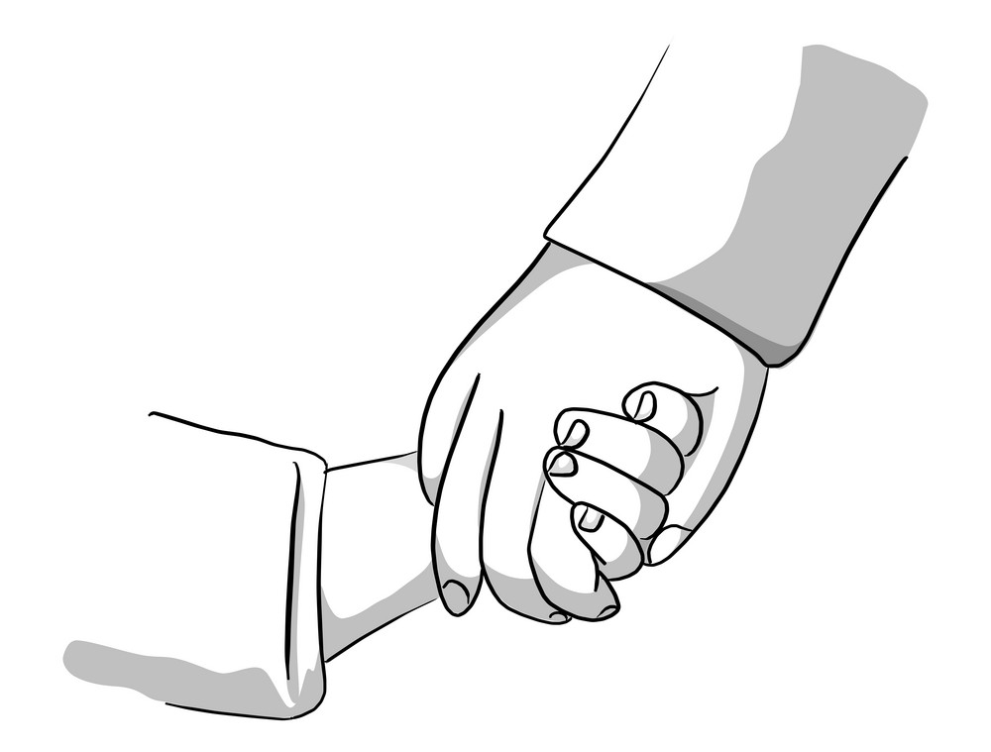
Placing a child or young person in care
Care arrangements

Slide 12
Placing a child or young person in care
Care arrangements
Placing a child or young person in care is a safety intervention.
Child Safety acknowledge that families are the experts in caring for their children and/or young people
Care arrangements are required to ensure the safety, belonging and wellbeing needs for children and young people
There are various types of care arrangements with each requiring a different approach to ensure it meets the needs of the child or young person.

Slide 13
Care Arrangements
Primary care arrangement
The place where a child or young person is living the majority of the time.
Short break (Respite) care arrangement
A short break can include a short stay with an approved foster or kinship carer for children and young people away from their primary carer. A child or young person returns to their primary carer after the period of a short break.
A short break can provide support to the child and the primary carer.
The use of a short break should be part of an approved case plan, negotiated between the carer, Child Safety and the foster and kinship care service.

Slide 14
Care Arrangements cont.
Types of care arrangements
Family based care - The most common form of care arrangement involves family-based care, where children live with approved foster or kinship carers.
Residential Care - A residential care arrangement is where young people live with other young people, supported by youth workers. They live in premises owned or rented by an organisation funded and licensed to provide the service.
Therapeutic Residential Care - A therapeutic residential care service for young people with complex to extreme needs who are unable to be placed in foster or kinship care, or other forms of residential care. This care arrangement is a time-limited (12–18 months)
Aboriginal and Torres Strait Islander Safe Houses - Are located in Aboriginal and Torres Strait Islander communities, to enable children to safely remain in, or return to, their communities of origin.
Supported Independent Living (SIL) - Young people (15 years or older) living in a residential setting, supported by case/youth workers on a structured support model. Workers generally do not live in the house but provide external support through regular visiting. This model of care provides young
Other entities –
Fee for service models (Individualised Placement and Support – IPS)
Commercial Accommodation (hotels)

Slide 15
Other care arrangement types
Emergency care arrangement
An Emergency care arrangement occurs only in a crisis situation with minimal planning. They are an interim measure until a more suitable or stable care arrangement option is located for the child or young person.
Emergency care arrangements are likely to be required when:
A child is removed from family in urgent circumstances.
A family with whom Child Safety is working with unexpectedly requires a care arrangement.
A child or young person’s foster or kinship care arrangement breaks down suddenly.
Emergency care arrangements can be very disruptive to children, pre planning and discussing your concerns early can help avoid a care arrangement breakdown and emergency situation.

Slide 16
Types of abuse and harm
Type of abuse Actions behaviours by parent/carer | Physical | Emotional | Sexual | Neglect
 | Hitting Punching Scalding Domestic and family violence | Scapegoating Rejection Persistent hostility Domestic and family violence | Penetration Sexual exploitation Exposure to pornography Grooming | Failure to attend to medical needs Poor hygiene / nutrition Inadequate supervision
Resulting harm Impact experienced by the child | Physical Refers to the body | Emotional Refers to the ability to express emotions | Psychological Refers to the mind and cognitive processes
 | Bruising Fractures Internal injuries Burns | Depression Hyper vigilance Poor self esteem Self harm Fear / anxiety | Learning and developmental delays Disorganised attachment Impaired self image In infants, neurological changes in the developing brain

Slide 17
What types of harm and abuse can you identify in the case studies?

Slide 18
Who is involved in decision making?
The child and their family
Child Safety Service Centre Staff | Child Safety Officer, Senior Team Leader, Senior Practitioner, Manager, OCFOS.
Carer | Day to day decision making and depending on a child or young person’s order type carer’s may be delegated to make additional decisions for a child or young person
Independent person | (Aboriginal and Torres Strait Islander children) – when engaged by the child or family
Other services | Office of the Public Guardian, Community Visitor, SCAN, school staff, police, hospital staff, GP, family, counsellors, non government agencies – provide information about the child and family to assist with decision making.
Director of Child Protection Litigation (DCPL) | An agency that is independent of Child Safety and is responsible for deciding whether to apply for child protection orders.
Magistrate | Decides the child protection order and any conditions when parents disagree with intervention
Foster and Kinship Care Agency | Responds to referral requests from the Placement Services Unit with the appropriate carer for the child and provides the carer support and information, in exceptional circumstances Child Safety may also perform this role directly through the Placement Services Unit.

Slide 19
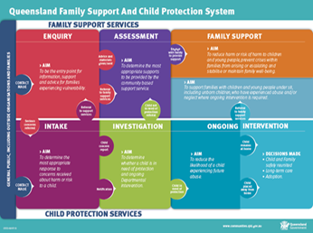
Child Protection System
Overview

Slide 20
Overview of the Child Protection System
Intake
Aim
Determine the most appropriate response to an allegation of harm or risk of harm.
Action taken
Information gathered from caller or relevant persons where required
Decision
Referral to FACC
Child Concern Report
Notification
Investigation and Assessment
Aim
Determine if a child is in need of protection.
Actions taken
Information gathered from child, family and relevant persons to determine level and length of intervention. The child’s safety, harm and risk of harm are assessed.
Decision
Child in need of protection
Child not in need of protection
Child to stay at home or be placed elsewhere
Ongoing Intervention
Aim
Ensure a child in need of protection receives quality care and protection
Actions taken
Casework with the family to return the child, placement of child where required.
Decision
Child to return home where safe
Child to remain in care
Length of intervention and type of child protection order where required

Slide 21
Types of Intervention and Child Protection Orders
The duration and purpose of intervention and the subsequent care arrangement, where required, varies according to the needs of the child, young person and their family as well as the type of intervention or child protection order the child or young person is subject to.
Types of intervention include:
Order Type | Child or young person can be placed
Intervention with Parental Agreement (IPA)– no child protection order | At home with parent/s
Care Agreement (CA) – no child protection order | with kinship or foster carer
Temporary Assessment Order (TAO) | with kinship or foster carer
Temporary Custody Order (TCO) | with kinship or foster carer
Court Assessment Order (CAO) | with kinship or foster carer
Short Term Custody Order (STC) | with kinship or foster carer
Short Term Guardianship Order (STG) | with kinship or foster carer
Long Term Guardianship Order to the Chief Executive (LTG-CE) | with kinship or foster carer
Long Term Guardianship Order to a suitable person (LTG-O) | with Long term guardian
Permanent Care Order (PCO) | with permanent guardian

Slide 22
Types of Intervention and Child Protection Orders
Intervention with Parental Agreement (IPA)
Key aspects of IPA
support and assistance without the use of a court order
short term and intensive work with parental agreement
it must be safe for the child to remain at home
on occasions the child may be placed in a care arrangement with the use of a child protection care agreement, if required.

Slide 23
Types of Intervention and Child Protection Orders
Care Agreement
A Care Agreement is an agreement between Child Safety and the child’s parent for the short –term care arrangement of their child in the care of someone other than the parents.
There are 2 types of care agreements:
Assessment care agreement – cannot be extended past 30 days
Child protection care agreement – generally sought for no more than 30 days but can be extended for a period up to 6 months

Slide 24
Types of Intervention and Child Protection Orders
Temporary Assessment Order (TAO)
Temporary Custody Order (TCO)
A Temporary Assessment Order can be made for up to 3 business days, however can be extended for 1 business day only.
A TAO is sought when Child Safety is assessing if the child is in need of protection.
Child Safety has custody of the child or young person while the parent retains guardianship.
Has the same purpose as the TAO above, however is used when Child Safety has already decided that a child is in need of protection.
A Temporary Custody Order can be made for up to 3 business days and can be extended for 1 business day only if required.
Child Safety has custody of the child or young person and the parent retains guardianship.

Slide 25
Types of Intervention and Child Protection Orders
Court Assessment Order (CAO)
A Court Assessment Order can be made for twenty-eight (28) days with a possible extension of a further 28 days.
A child will usually be placed in a care arrangement while the assessment of harm, risk of harm and child in need of protection continues.
Child Safety has custody of the child or young person and the parent retains guardianship

Slide 26
Types of Intervention and Child Protection Orders
Short-Term Guardianship Order (STG)
Short-Term Custody Order (STC)
This order is suitable when the case plan goal is to reunify the child with their family. The order can grant custody of the child to Child Safety or a suitable family member.
The maximum time frame a STC order can be made for is 2 years.
Child Safety has custody, or if the order is made to a suitable family member, the suitable family member has custody
The parent retains guardianship
This order is suitable when the case plan goal is to reunify a child with their family but the family is unable or unwilling to make significant decisions about the child's care.
The maximum time frame a STC order can be made for is 2 years.
Child Safety has both custody and guardianship

Slide 27
Types of Intervention and Child Protection Orders
Long-Term Guardianship Order to a suitable person (LTG-O)
Long-Term Guardianship Order to the Chief Executive (LTG-CE)
This order is suitable when the child or young person cannot be safety reunified with their parent and long-term care would best protect and care for the child.
The order will grant long-term guardianship to Child Safety until the child or young person turns 18.
This order is suitable when the child or young person cannot be safety reunified with their parent, and long-term care would best to protect and care for them
The order will grant long-term guardianship to a suitable family member, or other suitable person until the child or young person turns 18.
LTG-O order Case Plans are reviewed:
if requested by the child or long-term guardian at the 12-monthly contact and if Child Safety agrees to the review
at any point in time if requested by the child or long-term guardian and Child Safety agrees to the review
if Child Safety considers it necessary.

Slide 28
Types of Intervention and Child Protection Orders
Permanent Care Order (PCO)
A permanent care order is an order that gives responsibility for parenting a child to a person other than the child’s parents.
This person becomes the child’s “permanent guardian” until the child reaches 18 years of age, and they will be responsible for providing for the child’s care and upbringing.
A permanent care order does not sever the child’s legal relationship with their parents or change the child’s legal identity. However, the guardian does take on most aspects of parenting, including providing care and making decisions.
As the guardian takes on parental responsibility for the child, Child Safety’s ongoing role becomes very limited.
A permanent guardian will continue to receive the foster care allowance until the child or young person turns 18.
A permanent care order can only be revoked by the Department of Child Protection Litigation (DCPL)

Slide 29
Other child protection orders
Directive Orders
The Childrens Court can make a directive order when it is assessed the child is in need of protection but can safely remain at home if the parents take certain actions.
Protective Supervision Order
The Childrens Court can make a Protective Supervision order when it is assessed the child is in need of protection but supervision will enable:
The child to safely remain at home and
Supervision of the child’s wellbeing for the period of the supervision order

Slide 30
Activity

Slide 31
Working together to meet the rights and needs of children and young people

Slide 32
Child Safety, carers, agencies and other stakeholders have a shared responsibility to ensure that a child in care has their rights and needs met.

Slide 33
Rights and needs of children and young people
Principles of the Act
Human Rights Act 2019
Meeting the child’s needs:
Charter of Rights
Gender and sexual orientation identity
The Safety and Support Network
Roles and Responsibilities:
Case plan
Cultural plan
Child Strengths and Needs Assessment (CSNA)
Roles in a Child Safety Service Centre (CSSC)
Roles of a Licensed Care Service
Summary

Slide 34
Principles of the Child Protection Act 1999
There are a number of Principles within Child Protection Act 1999 to ensure the protection of children and young people
Principles of the Act include:
Paramount Principle (section 5A)
Other General Principles (section 5B)
Principles for achieving permanency for a child (section 5BA)
Additional principles for Aboriginal or Torres Strait Islander children (section 5C) - Child Placement Principle
Additional provisions for placing Aboriginal and Torres Strait Islander children in care (section 83)
Principles about exercising powers and making decisions (section 5D)
Obtaining child’s views (section 5E)
(please refer to your ‘Principles of the Act’ handout for more detailed information)

Slide 35
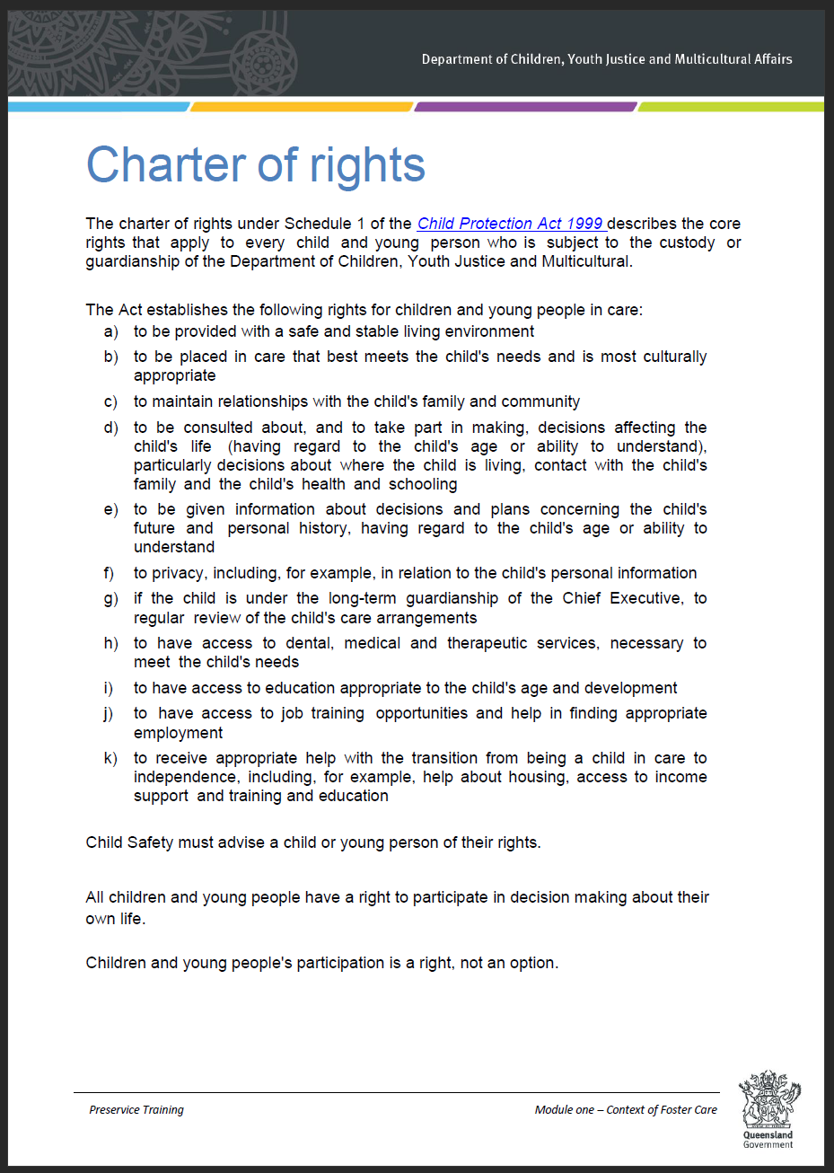
Meeting a child’s rights and needs
Charter of Rights for a Child in Care
It is the responsibility of the Safety and Support Network to ensure a child or young person’s needs are met.
The Child Protection Act 1999 (Schedule 1) establishes the rights for a child or young person in care through the Charter of Rights
Please refer to your handout for more detailed information

Slide 36
Activity

Slide 37
Principles of the Child Protection Act 1999
Additional principles for Aboriginal or Torres Strait Islander children (section 5C) -
Child Placement Principles (refer to handout)
The following additional principles apply for administering this Act in relation to Aboriginal or Torres Strait Islander children:
Aboriginal and Torres Strait Islander people have the right to self-determination.
the long-term effect of a decision on the child’s identity and connection with the child’s family and community must be taken into account.
The following principles (the child placement principles) also apply in relation to Aboriginal or Torres Strait Islander children:
the prevention principle - a child has the right to be brought up within the child’s own family and community
the partnership principle - Aboriginal or Torres Strait Islander persons have the right to participate in significant decisions under this Act about Aboriginal or Torres Strait Islander children;
the placement principle - if a child is to be placed in care, the child has a right to be placed with a member of the child’s family group;
the participation principle - a child and the child’s parents and family members have a right to participate, and be enabled to participate, in an administrative or judicial process for making a significant decision about the child;
the connection principle - a child has a right to be supported to develop and maintain a connection with the child’s family, community, culture, traditions and language, particularly when the child is in the care of a person who is not an Aboriginal or Torres Strait Islander person.

Slide 38
Principles of the Child Protection Act 1999
Additional provisions for placing Aboriginal and Torres Strait Islander children in care (section 83)
83(2) -The chief executive must, in consultation with the child and the child’s family, arrange for an independent Aboriginal or Torres Strait Islander entity for the child to facilitate the participation of the child and the child’s family in the process for making a decision about where or with whom the child will live.
83(3) - However, the chief executive is not required to arrange for the involvement of an independent Aboriginal or Torres Strait Islander entity for the child under subsection (2) if—
it is not practicable because an entity is not available or urgent action is required to protect the child; or
the chief executive is satisfied that an entity’s involvement—
is likely to have a significant adverse effect on the safety or psychological or emotional wellbeing of the child or any other person; or
is not otherwise in the child’s best interests; or
c) the child or the child’s family does not consent to the entity’s involvement.

Slide 39
Principles of the Child Protection Act 1999
Additional provisions for placing Aboriginal and Torres Strait Islander children in care (section 83)
s83(4) - In making a decision about the person in whose care the child should be placed, the chief executive must, if practicable, place the child with a member of the child’s family group.
S83(5) - However, if it is not practicable to place the child with a member of the child’s family group, in making a decision about the person in whose care the child should be placed, the chief executive must place the child with
a member of the child’s community or language group; or
if it is not practicable to place the child in the care of a person mentioned in paragraph (a), an Aboriginal or Torres Strait Islander person who is compatible with the child’s community or language group; or
if it is not practicable to place the child in the care of a person mentioned in paragraph (a) or (b), another Aboriginal or Torres Strait Islander person; or
if it is not practicable to place the child in the care of a person mentioned in paragraphs (a) to (c), a person who—
lives near the child’s family, community or language group; and
has a demonstrated capacity for ensuring the child’s continuity of connection to kin, country and culture.

Slide 40
Principles of the Child Protection Act 1999
Additional provisions for placing Aboriginal and Torres Strait Islander children in care (section 83) (cont.)
S83(6) - Also, the chief executive must give proper consideration to—
the views of the child and the child’s family; and
ensuring the decision provides for the optimal retention of the child’s relationships with parents, siblings and other people of significance to the child under Aboriginal tradition or Island custom.
S83(7) - Before placing the child in the care of a family member or other person who is not an Aboriginal person or Torres Strait Islander, the chief executive must give proper consideration to whether the person is committed to—
facilitating contact between the child and the child’s parents and other family members, subject to any limitations on the contact under section 87; and
helping the child to maintain contact with the child’s community or language group; and helping the child to maintain a connection with the child’s Aboriginal or Torres Strait Islander culture; and
preserving and enhancing the child’s sense of Aboriginal or Torres Strait Islander identity.

Slide 41
Human Rights
Queensland’s Human Rights Act was passed by State Parliament in February 2019.
Queensland’s Human Rights Act 2019 protects 23 human rights in law.
The Human Rights Act 2019 protects the rights of everyone in Queensland and requires the Queensland public sector to act and make decisions which are compatible with these rights.
The Human Rights Act 2019 requires ‘public entities’ to consider human rights in all decision-making and action, and only limit human rights in certain circumstances and after careful consideration. When delivering services and interacting with the community, public entities must:
act compatibly with human rights when making decisions or taking actions
give proper consideration to human rights when making decisions or taking actions.
These obligations apply to Child Safety staff, as employees of a public entity under the Human Rights Act 2019 and apply to all aspects of decision making that is undertaken by Child Safety staff, who have a responsibility to respect, protect and promote the human rights of individuals.
Carers are also considered under this ‘public entity’ and have a responsibility to ensure that the decisions made for children and young people in their care are also in line with the Human Rights Act.

Slide 42
Human Rights (cont.)
The 23 human rights are not absolute - that is, they are allowed to be limited, but only in a way that is necessary, justifiable and proportionate.
Your right to recognition and equality before the law
Your right to life
Your right to protection from torture and cruel, inhuman or degrading treatment
Your right to freedom from forced work
Your right to freedom of movement
Your right to freedom of thought, conscience, religion and belief
Your right to freedom of expression
Your right to peaceful assembly and freedom of association
Your right to taking part in public life
Property rights
Your right to privacy and reputation
Your right to protection of families and children
Cultural rights – generally
Cultural rights – Aboriginal peoples and Torres Strait Islander peoples
Your right to liberty and security of person
Your right to humane treatment when deprived of liberty
Your right to a fair hearing
Rights in criminal proceedings
Rights of children in the criminal process
Right not to be tried or punished more than once
Retrospective criminal laws
Right to education
Right to health services

Slide 43
Meeting the child’s rights and needs
Gender and sexual orientation diversity
Everyone has a sexual orientation and gender identity. Some of the children and young people you care for may have diverse genders and sexual orientations, which means that they may not be heterosexual (they may not be solely attracted to people of the opposite sex) or may not be cisgender (their sense of gender may not correspond with their assigned sex at birth).
Respectfully understanding the gender identity and sexual orientation of the children, young people, parents and carers we work with helps us to make better decision about appropriate care arrangements for children and how we can best work with family-based carers to meet the needs of children and young people with diverse genders and sexual orientations.
It is critical to affirm the gender identity and sexual orientation of the children and young people you care for. When a child or young people’s sexual orientation and gender identity is honoured and affirmed, it results in the child or young person experiencing increased safety, a stronger sense of belonging, and improved wellbeing.

Slide 44
Meeting the child’s rights and needs
Gender and sexual orientation diversity
The term LGBTIQA+ is broken down as:
L - lesbian (a female who is attracted to females)
G - gay (someone who is attracted to people of the same gender)
B - bisexual (someone who is attracted to people of more than one gender)
T - transgender
I - intersex (someone who is born with reproductive or sexual anatomy that falls outside the typical definitions of ‘male’ and ‘female’)
Q - queer - an umbrella term used by some LGBTIQA+ people to refer to themselves and the LGBTIQA+ community. (Note: this is an ‘ingroup term that can be considered offensive to some but has been reclaimed by many as a proud term to describe sexuality or gender that is anything other than cisgender (a person whose gender corresponds with their sex assigned at birth) and/or heterosexual)
A – asexual (someone who has low or no sexual attraction to any gender, but may have a romantic attraction towards another person)
+ - this acknowledges there are many other diverse sexual orientations and gender identities.

Slide 45
Meeting the child’s rights and needs
Gender and sexual orientation diversity
Child Safety is committed to meeting the safety, belonging and wellbeing of all children and young people subject to statutory intervention, including children and young people with diverse genders and sexual orientations.
As a carer, you will be required to:
support the wellbeing of children and young people with diverse genders and sexual orientations, including affirming their gender and sexual orientation
work with Child Safety staff and partners to ensure children and young people with diverse genders and sexual orientations are provided with support and access to services they need to safety explore, express and affirm their gender identity and sexual orientation
ensure you are not directly or indirectly discriminating against a child or young person due to their sexual orientation, gender identity or gender expression.

Slide 46
The Safety and Support Network
A safety and support network is made up of a range of people, and could include family members, professionals, carers and community members.
The membership of the network will be different for every child and young person, and for some may include only departmental and professional workers at the start.
Over time the aim of the Safety and Support network is to build the network to parents, family, friends, community members, carers and professionals who:
care about the child or young person
are willing to meet with the Child Safety and other key people
have an understanding of the harm that has occurred
have an understanding of the worries and risks for the future
are willing to take actions that support the family and help keep the child or young person safe.

Slide 47
The Safety and Support Network
An important difference between a Safety and Support Network and a more general ‘group of concerned people’ is that Safety and Support Network members know the harms that have already been experienced and the worries and goals for the future. That is, they know the risks of future harm to the child or young person should nothing change in the family or if new issues emerge.
The key premise for any Safety and Support Network is that network members are:
informed
willing to help, and
clear about what they must do to respond.

Slide 48
Roles within a Child Safety Service Centre
CSSC Manager
Senior Practitioner
Senior Team Leader
Child Safety Officer
Child Safety Support Officer
Cultural Practice Advisor
OCFOS Lawyer (Legal Officer)
Family Group Meeting Convenor
Administrative Staff
Business Support Officer

Slide 49
Roles within a licensed care services
Foster and kinship care services are funded to recruit, train, assess and support foster and kinship carers and to manage and monitor the quality of care arrangements provided to children and young people.
Services operate in a particular region and CSSC catchment areas. Services identify carers best able to meet the needs of children and young people referred by Child Safety.

Slide 50
Meeting the child’s rights and needs
Child Safety roles and responsibilities
Case Plan
A case plan for a child is a written plan for meeting the child's protection and care needs. It is developed in a participative process between Child Safety, a child, the child's family and other people of significance to the child and family. It records the goals and outcomes of ongoing intervention and identifies the agreed tasks that will occur to meet the goal and outcomes.
Cultural Support Plan
The cultural support plan is an essential component of the case plan for an Aboriginal or Torres Strait Islander child or a child from another cultural community. It is completed when a child is in need of protection, to ensure they remain connected with their culture, families and communities regardless of where they are living.
Child’s Strengths and Needs Assessment (CSNA)
Child Safety carries out an assessment for each child in care. Carers participate in case planning, goals, actions and tasks to meet any of the assessed needs of the child, including:
Behaviour
Emotional stability
Alcohol and drug use
Family of origin relationships
Social relationships
Cultural identity
Physical health
Child development and intellectual ability
Education / vocation / employment
Additional child strengths and/or needs identified
Life skills for young people aged 15 years and over
Relationship with carer family

Slide 51
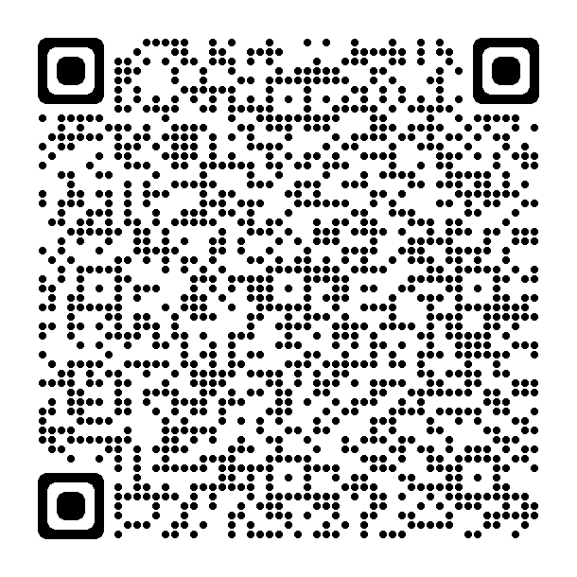
Critical Incident Reporting
As a carer you may be the first person to become aware of a major incident regarding a child or young person in your care.
Child Safety requires carers to, respond to and report events which negatively impact, or have the potential to negatively impact on the safety, well-being and best interests of a child or young person in care.
Carers are to report directly to Child Safety and where necessary contact emergency services on 000
In reporting critical incidents to Child Safety carers are meeting their legislative obligation
There are 2 categories for critical incident reporting to Child Safety:
Category 1 – reporting response - immediate or as soon as practical (given the circumstance) and may include but is not limited to:
Child death or child allegedly involved in the death of another person
Life threatening injury (hospitalisation)
Missing or abducted child or young person
Rape, sexual assault or other serious assault
Category 2 – reporting response - immediate, as soon a possible or at least by the next business day of you becoming aware of the incident, and may include but is not limited to:
Serious injury
Alleged harm, neglect or exploitation
Self-harm
Escalating risk taking behaviour
For more detailed information on Critical and major incidents reporting please scan the QR code

Slide 52
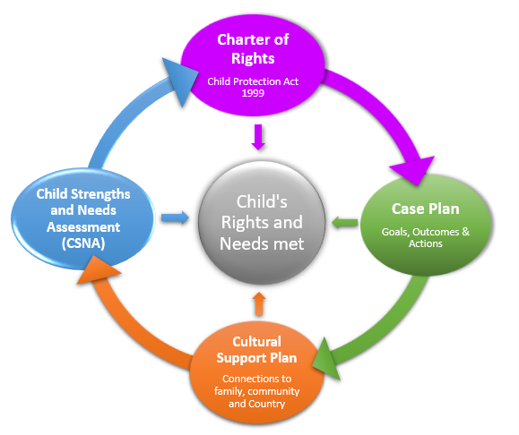
Meeting a child’s rights and needs
Summary
Working together in partnership enables a child’s or young person’s rights and needs to be met.

Slide 53
Activity

Slide 54
Carer Allowances

Slide 55
Carer Allowances
Types of Carer Allowances
Fortnightly caring allowance
Regional and remote loading
Establishment allowance
Start Up / Outfitting allowance
High Support Needs Allowance (HSNA)
Complex Support Needs Allowance ( CSNA)
Fortnightly Caring Allowance
The foster care allowance (or fortnightly caring allowance) is the base payment provided to all approved carer when providing direct care for a child cared for under the Child Protection Act 1999.
The foster care allowance is also paid to long-term guardians and permanent guardians who were approved carers for the child prior to being granted long-term guardianship.
The allowance is paid fortnightly in arrears, at different rates depending on the age of the child.

Slide 56
Carer Allowances (cont.)
Regional and Remote loading
Regional and remote loading is an additional fortnightly payment in locations with higher retail prices. It is paid to carers residing in the child safety service centres (CSSC) areas of Cape York South (Cooktown), Cape York North and Torres Strait Islands (including Weipa and Thursday Island), Emerald, Gladstone, Mackay, Mt Isa, parts of Roma and applicable Aboriginal Councils and Indigenous communities.
Establishment Allowance
The Establishment allowance is a one-off payment provided the first time a child enters care. It is to assist the carer with establishment costs for ongoing care arrangements of one month or longer. Generally the items purchased remain the property of the child.
Start Up / Outfitting Allowance
The start-up/outfitting allowance is a one‐off payment for initial set up costs to establish appropriate accommodation and resources for a new placement longer than 5 nights, including respite care placements. This allowance may be paid for placements less than 5 nights depending on the child’s need and the individual circumstances of the carer.

Slide 57
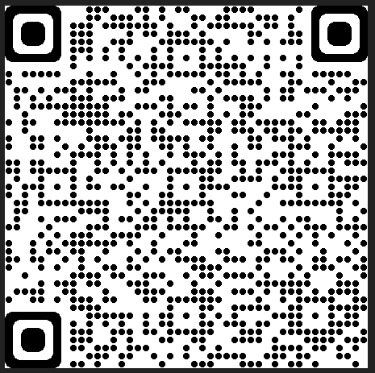
Carer Allowances (cont.)
High Support Needs Allowance (HSNA)
The HSNA may be provided to assist a carer with the direct care costs of a child assessed as having a high level of support needs where the needs consistently result in costs exceeding the fortnightly caring allowance.
The HSNA will be approved for a set period or on an ongoing basis (for a child with ongoing medical or psychological needs).
Complex Support Needs Allowance (CSNA)
The CSNA may be provided to assist a carer meet the direct and additional indirect costs of caring for a child assessed as having a complex or extreme level of support needs, that consistently result in costs exceeding both the fortnightly caring allowance and HSNA, due to there being more costly expenses, a wider range of expenses and/or a greater frequency of expenses. The CSO will discuss with the carer and the agency support worker at a placement meeting, and will submit an application for the CSSC Manager's approval.
More information regarding Carer Allowances can be found at the following link or use the QR code provided to the right:
Carer allowances | Community support | Queensland Government (www.qld.gov.au)

Slide 58
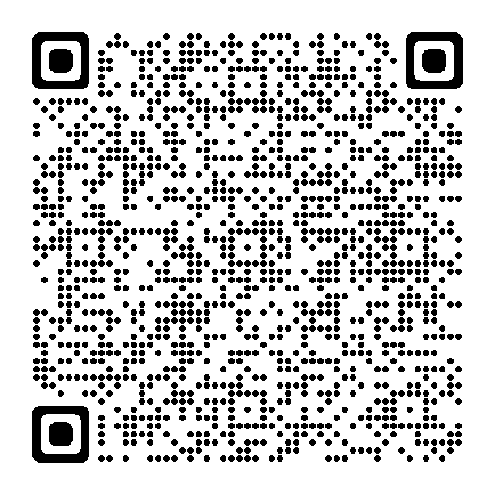
Australian government financial support
Carers may be eligible to receive family and parenting payments from the Australian government.
Family tax benefits part A and B (FTB)
As a foster or kinship carer you may be eligible for the Family Tax benefit parts A and B
You must meet an income test and there are residency and other requirements
For more information on the FTB please refer to the website below or scan the QR code:
Family Tax Benefit - Services Australia
Child Care subsidy
Is a single means-tested subsidy paid directly to child care service providers to reduce the cost of child care for eligible families
If you meet the eligibility requirements you may be eligible for the Additional Child Care Subsidy (Child Wellbeing) for up to 100 hours of subsidised child care per fortnight.
All children in care who have been assessed as being ‘in need of protection’ under the Child Protection Act 1999 will automatically satisfy the ‘at risk’ threshold for the Child Wellbeing subsidy.
For more information please on the Child Wellbeing subsidy please refer to
the following web site or scan the QR code.
Child Care Subsidy - Department of Education, Skills and Employment, Australian Government (dese.gov.au)

Slide 59
Foster and Kinship Carer Supports

Slide 60
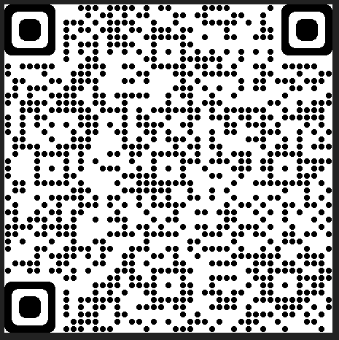
Supports for Foster and kinship carer’s
Carer Connect
Carer connect is a user friendly desktop and mobile app that can be downloaded through the Apple Store or Google Play.
The app has been developed to support carers in having important information on hand when require about the children and young people in their care.
Some key features include:
Access to secure information for children and young people
make contributions to the life story for children and young people in their care using kicbox
view noticeboard articles that announce everything from training and social events to legislation changes.
submit claims for Child Related Costs reimbursements for children and young people currently in their care and which have been pre-approved by the Department.
view and build children and young people’s “Who am I” profile – valuable
To get a better understanding of Carer Connect please watch the video below
Carer Connect video
More information can be found at the link below or use the QR code provided:
Carer Connect | Community support | Queensland Government (www.qld.gov.au)

Slide 61
Support for Foster and Kinship Carers
Emotional, psychological support and practical support - Regular visits by your non-government support worker, Support line and Community Visitor
Social support - FAST representatives, Foster and Kinship Care worker
Training – Getting ready to start, Starting out, Continuous learning modules
Resources
Information for existing carers website https://www.qld.gov.au/community/caring-child/foster-kinship-care/information-for-carers
Carer Connect app
Task focused problem solving – Queensland Foster and Kinship Carer support line, Foster and Kinship Care worker, Child Safety staff
Respite or Short break
Community support groups - FAST delegate, support groups, friends
Financial support - Federal and state government support, Carer Business Discount Card
Advocacy and support - Queensland Foster and Kinship Care (QFKC), Foster and Kinship Service, FAST representative

Slide 62
Snap the Stigma
Change the pre-conceived views that people may have about young people with a care experience.

Slide 63
Summary module one: Context of foster care
Learning Outcomes
Do you feel confident that you can:
Explain why children can require care arrangements.
Demonstrate knowledge of how children come into care and who is involved in decision making.
Identify the needs of children in care, and the roles and responsibilities of foster carers in meeting those needs.

