Slide 1
Queensland Disability Advocacy Framework 2023 - 2026
Advocacy supports people with disability, their families and carers to:
have their voice heard on issues important to them
defend and safeguard their rights
access mainstream and NDIS services
build their capacity through self-advocacy.
Objective People with disability have access to effective disability advocacy that promotes, protects and advances their rights, interests and wellbeing, enabling full community participation and inclusion.
Principles
The Queensland Government supports advocacy for people with disability, their families and carers. This framework outlines the Queensland Government’s approach to supporting disability advocacy in Queensland.
Presumption of rights and capacity
Safeguards and justice
Participation, inclusion and access to supports
Self-determination
Approaches that meet the needs of First Nations people with disability
Understanding of and respect for intersectionality and diversity
Types of advocacy Self-advocacy Legal advocacy Group advocacy Individual advocacy Disability advocacy Systemic advocacy
Specific cohorts People from culturally and linguistically diverse backgrounds Children and young people with disability First Nations peoples with disability
Priorities Ethical Rights-based Person-centred Culturally sensitive Duty of care Codesign Evolving nature of disability
International, national and state context
International | United Nations Convention on the Rights of Persons with Disabilities
National | Australia’s Disability Strategy 2021-2031 | National Disability Advocacy Framework
State | Queensland’s Disability Plan 2022-27: Together, a better Queensland | Queensland Disability Advocacy Framework
For accessible versions and more information visit www.qld.gov.au/qld-disability-plan

Slide 2
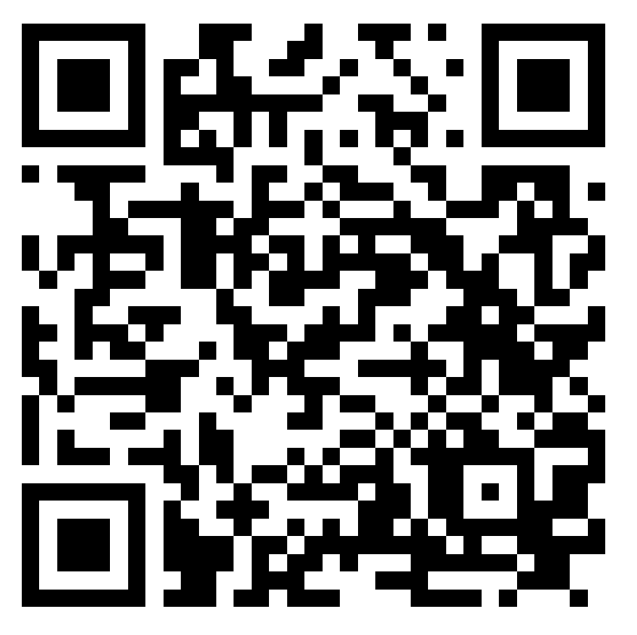
Supporting disability advocacy
An inclusive society that ensures people with disability can fulfil their potential, as equal members of the community
– vision of Queensland’s Disability Plan and Australia’s Disability Strategy
The Queensland Government has committed to the National Disability Advocacy Framework 2023-2025 (NDAF) and work plan.
Queensland Disability Advocacy Program
The Queensland Government funds the Queensland Disability Advocacy Program (QDAP) to deliver advocacy services to Queenslanders with disability, their family members and carers.
QDAP includes:
a statewide centralised phone advice and referral service
specialist individual advocacy services to priority cohorts
regional individual advocacy services for all people with disability.
National Disability Advocacy Work Plan
The Australian Government and state and territory governments have agreed to six priority areas to improve national consistency and access to disability advocacy services:
1. Measuring and reporting the outcomes of the NDAF
Develop a measure of outcomes for the Framework.
2. Improving data consistency
Explore existing data collection practises across jurisdictions.
3. Improving service delivery
Conduct a mapping exercise to identify where current individual disability advocacy services are available.
4. Sector development and support
Develop a national sector development project.
5. Better coordination of funding
Review existing funding arrangements and identify opportunities to better coordinate funding.
6. Supporting access for First Nations people
Increasing culturally appropriate and accessible advocacy services for First Nations people with disability.
QDAP provides statewide advocacy services which help people with disability:
to understand their rights
to address discrimination, conflict and unfair treatment
to build capacity to advocate for themselves
to navigate the National Disability Insurance Scheme (NDIS) and other mainstream services
address gaps in support
to make informed decisions
ensure fundamental needs are met
through legal matters
with information and referrals to disability support services.
Systemic advocacy
Systemic advocacy works for broader social or service changes to ensure the collective rights and interests of people with disability are upheld through legislation, policies and practices.
The Queensland Disability Advocacy Program and the Queensland Disability Peak and Representative Bodies Program fund organisations to provide advice to governments and inquiries on systemic issues affecting people with disability.
Find out more about disability advocacy supports by scanning the QR code or visiting
www.qld.gov.au/disability/legal-and-rights/advocacy.

